Slide 2
Safety Guidelines
COVID-19

Slide 3
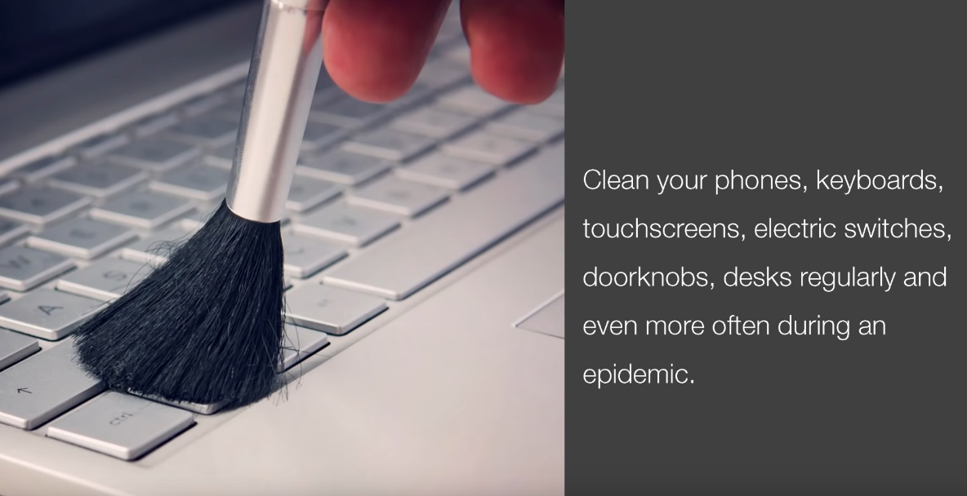
Guidelines on must have
Ensure availability of following :
PPE Equipment (Thermal Temp Scanner, Mask, Gloves etc.)
Liquid soap bottles only
Sanitizers
Disinfectants for cleaning
Paper Tissues
Clean drinking water
Arogya Setu App on all co-workers phone

Slide 4
Housekeeping Guidelines
Use disinfectants to clean all the surfaces
Entry & Exit gate of building must be disinfected after every 4 hours
Walls & other surfaces also needs to be disinfected and cleaned
Washbasin and washroom must be kept clean to avoid any infection
All machinery in the premise must be disinfected with disinfectant spray
2hr
Sanitation & housekeeping in the facility after every 2 hours and before new shift starts
Spitting inside or outside premise is a punishable offence with fine.

Slide 5
Workplace shift & people entry guidelines
1hr
Create the gap of one hour between the shifts
Ensure area is cleaned with disinfectant before new shift
No overlap of shifts is permitted
Mandatory thermal scanning of everyone entering and exiting the area
Sick co-worker must be immediately sent back home and asked to take doctor consultation and rest.
Recording each exception case, sick co-worker information and sharing with HR function
There should be total ban on non-essential visitors at the work place
All vehicles entering the premise must be disinfected with spray

Slide 6
Co-workers hygiene guidelines
Wearing of mask or face cover is compulsory at all times such as:
in transit to work or home
during working at premise
during break periods
during interaction with other co-worker
Mandatory handwash of co-workers:
Wash your hands for at least 40 seconds
Before wearing mask or gloves
After removing mask or gloves
Break for 5 mins every hour for hand wash
Before & after lunch
Before & after tea breaks

Slide 7
Safety Communication Guidelines
Share on Display board COVID 19 Hospital/Clinic & Police station contact
All WHO posters must be implemented Prominently displayed at the site
All WHO posters must be implemented & prominently displayed at the site
Daily 10 minutes drill to explain do’s and don’ts to all co-workers

Slide 8
MHA SOP Procedure for Social Distancing
The following measures shall be implemented by all offices, factories and other establishments:
All areas in the premises including the following shall be disinfected completely using user friendly disinfectant mediums:
Entrance/gates of building/office etc.
Cafeteria & Canteens
Meeting room, conference halls /open areas available. veranda/entrance gates of sites/bunkers, porta cabins, building etc.
Equipment & Lifts
Washroom, toilet, sink, water points etc.
Walls / all other surfaces
For workers coming from outside, special transportation facilities will be arranged without any dependency on public transport system. These vehicles should be allowed to work only with 30-40 % passenger capacity.
All vehicles and machinery entering the premises should be disinfected by spray mandatorily.
Mandatory thermal scanning of everyone entering and exiting the workplace to be done.

Slide 9
MHA SOP Procedure for Social Distancing
Medical insurance for the workers to be made mandatory.
Provision for handwash and sanitizer preferably with touch free mechanism will be made at all entry and exit points and common areas. Sufficient quantities of all items should be available.
Workplace shall have a gap of one hour between shifts and will stagger the lunch breaks of staff, to ensure social distancing.
Large gatherings of meetings of 10 or more people to be discouraged. Seating at least 6 feet away from others on job sites and in gatherings, meetings and training sessions.
Not more than 2/4 persons (depending on size) will be allowed to travel in lifts or hoists.
Use of staircase for climbing should be encouraged.
There should be strict ban on gutka, tobacco etc and spitting should be strictly prohibited.
There should be total ban on non-essential visitors at site.
Hospitals/clinic in the nearby areas, which are authorized to treat COVID-19 patients, should be identified and the list should be available at the workplace all the times.

Slide 10
Preventive and post identification measures to be taken
COVID-19

Slide 11
Safety guidelines on Home Isolation
As an individual, it is our responsibility to take care of the health and safety of ourselves and others. We have prepared some key guidelines to manage a situation if we identify any COVID19 cases at the workplace or in our close network.
We need to ensure daily adherence of the key standard guidelines as below:
All co-workers must download Aryogya Setu App, it is mandatory.
Mandatory usage of PPE equipment at workplace such as mask and gloves
Ensuring usage of PPE is done as per the guideline of the product
Hand washing routine must be followed
There should be total ban on non-essential visitors at site
Social distancing to be maintained all the time

Slide 12
Safety guidelines on Home Isolation
Identification of a COVID19 mild/pre-symptoms in the co-worker
Immediate notification to the nearest medical authority. (Contact available at MHA website)
Follow up of COVID19 medical report to reconfirm
Identify the close contacts made at workplace
Information the reporting manager and LOB head and HR team
Instruction to the co-workers or people came in close contact with the affected co-worker to stay at home and Isolate him/herself for 14 days.
Immediate closing of the facility and sanitizing it before opening for operations
Not to allow any close contact or affected co-worker to join unless they have completed the treatment or quarantine basis the guidelines and being tested negative.
Replace the affected co-workers with the substitute workers till the time they can resume the work
Reallocation of the work accordingly to be done to new co-workers
Customers to be informed basis the guideline from LOB head.
Ensure regular follow with the affected co-worker or family and close contacts.

Slide 13
Safety guidelines on Home Isolation
General guidelines for Isolations, all guidelines of medical authority must be noted and followed along the below
Duration for isolation is 14 days
Isolated individual must stay in a well-ventilated single room preferably with an attached/separate toilet
Continue to work from home, under no circumstances step out of the house
Continue to check temperature and symptoms of COVID-19 including fever, cough, muscle aches or difficulty in breathing
Maintain social distance from elderly people, pregnant women, children and persons with co-morbidities within the household
Restrict your movement within the house
Wash your hands often thoroughly with soap and water or with alcohol-based hand sanitizer
Avoid sharing household items e.g. dishes, drinking glasses, cups, eating utensils, towels, bedding, or other items with other people at home
Wear a mask all the time. The mask should be changed every 6-8 hours and disposed of. Disposable masks are never to be reused.

Slide 14
Safety guidelines on Home Isolation
If you remain without symptoms for 14 days from the date of possible exposure, then you may return to work provided the location / office is open.
Each office or site will strictly follow the state or local authority safety guidelines without fail. Site Managers are responsible to ensure 100% implementation and adherence.
We care about your health. Please continue to keep in touch with your supervisor so we know how to support you during this time or reach out to your HR partner in case you need any further guidance

Slide 15
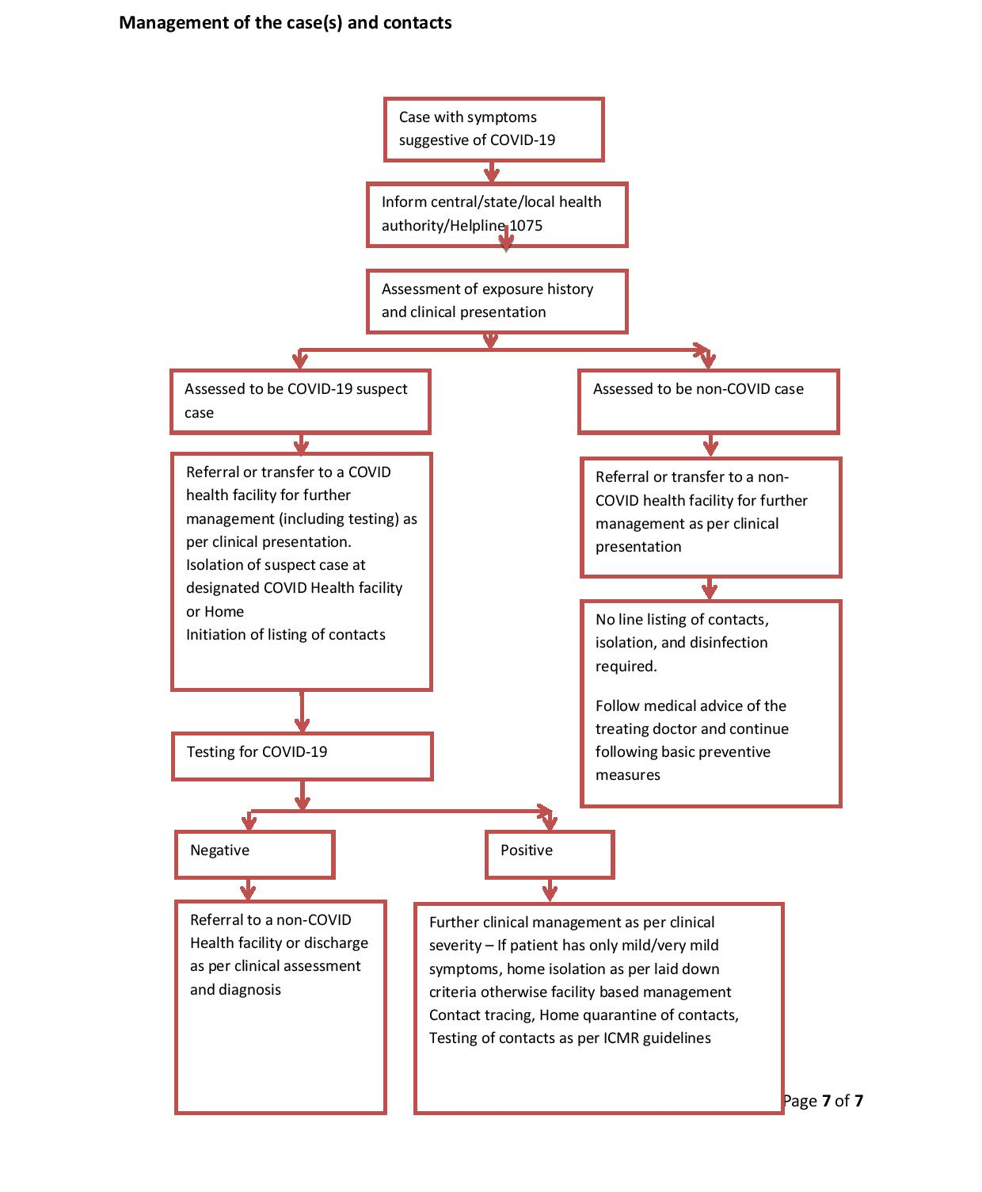
Flow chart for management of cases

Slide 16
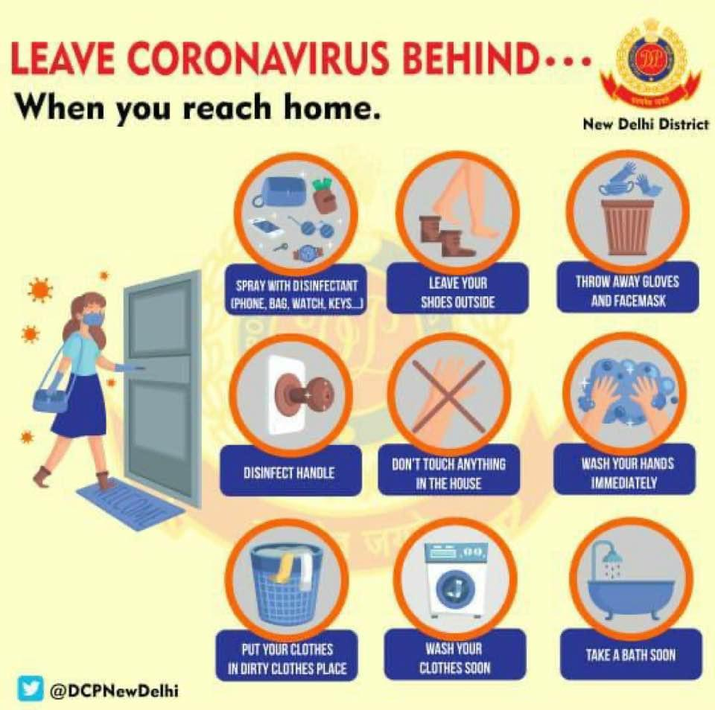
Safety guidelines to be followed when you reach home

Slide 17
Follow good respiratory hygiene

Slide 18
Follow good respiratory hygiene

Slide 19
Social distancing

Slide 20
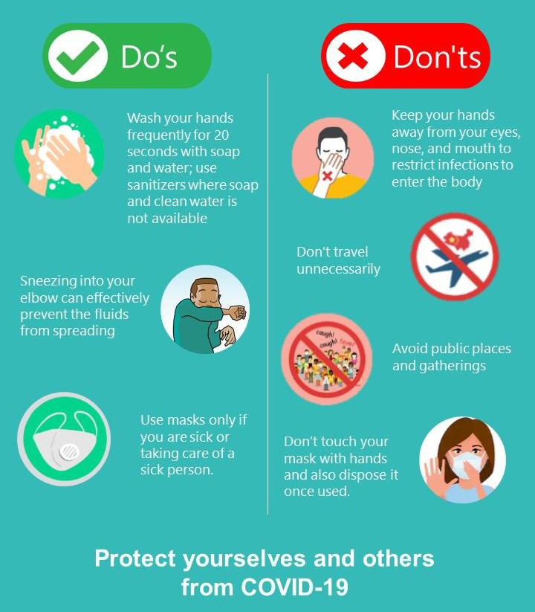
Do’s & Don’ts

Slide 21
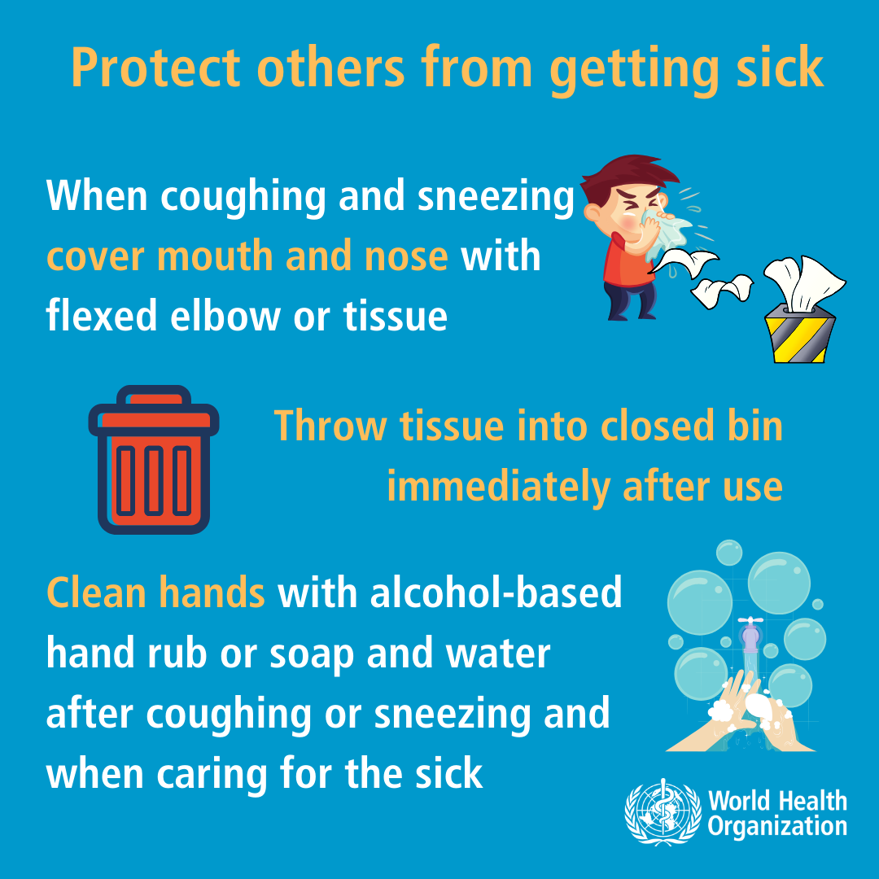
Do’s

Slide 22
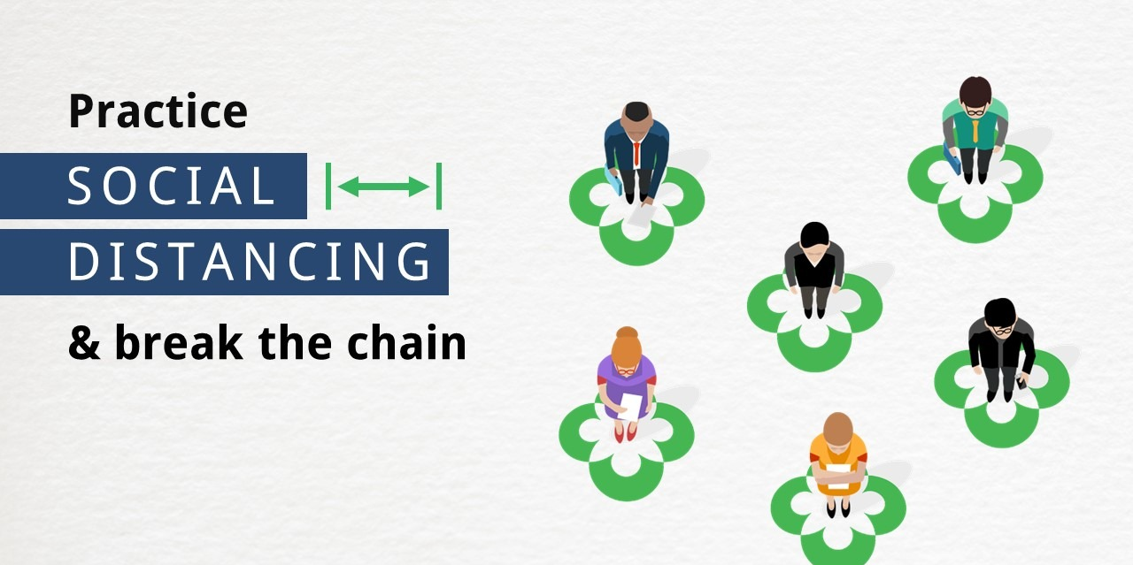
Do’s
2 Meter

Slide 23
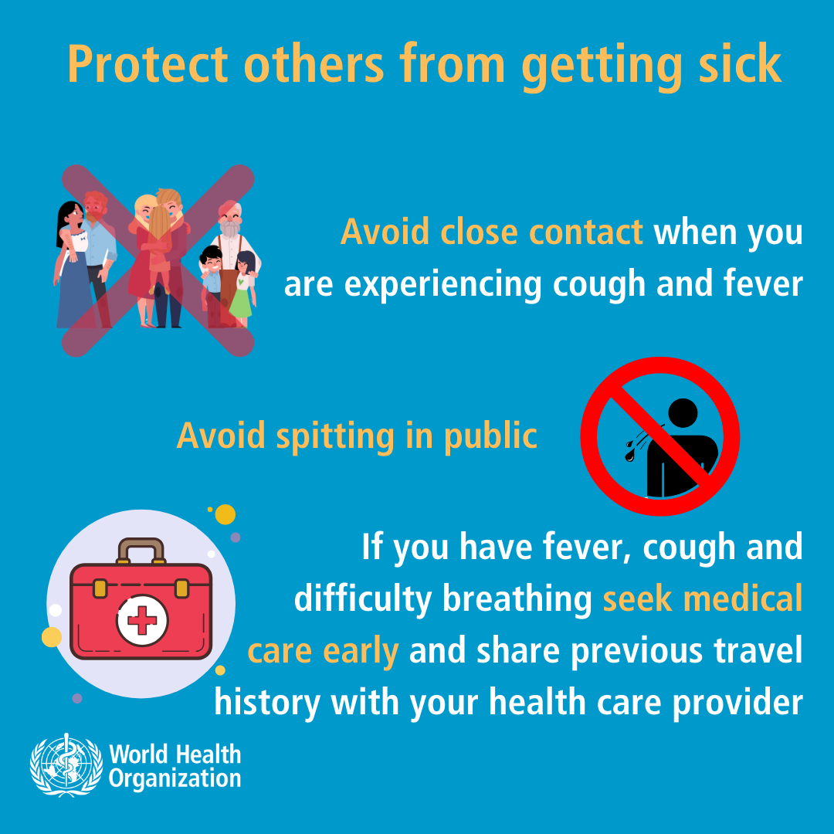
Don'ts

Slide 24
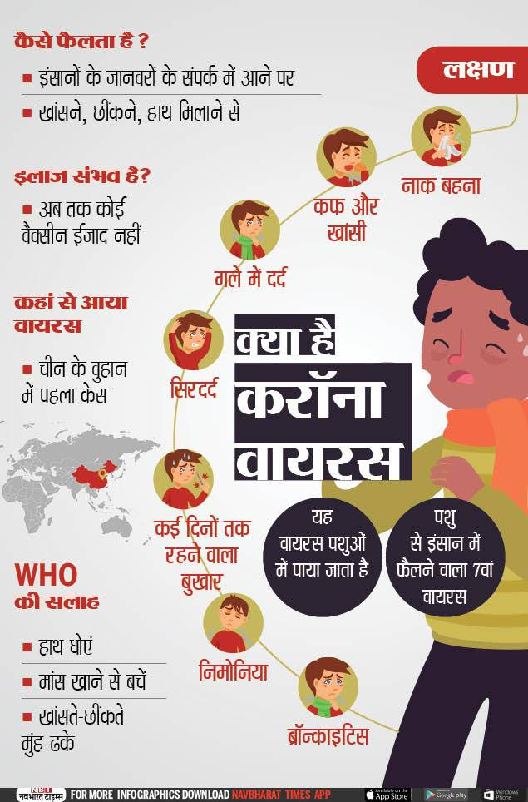
Educate Co-workers
How it spreads ?

Slide 25
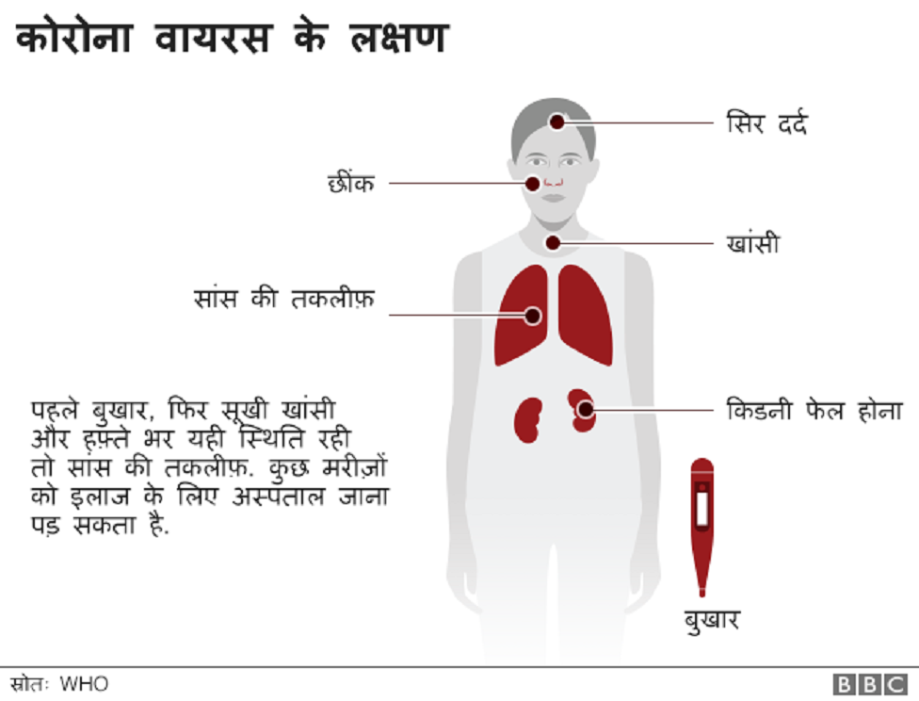
Educate Co-workers
Symptoms of COVID-2019

Slide 26
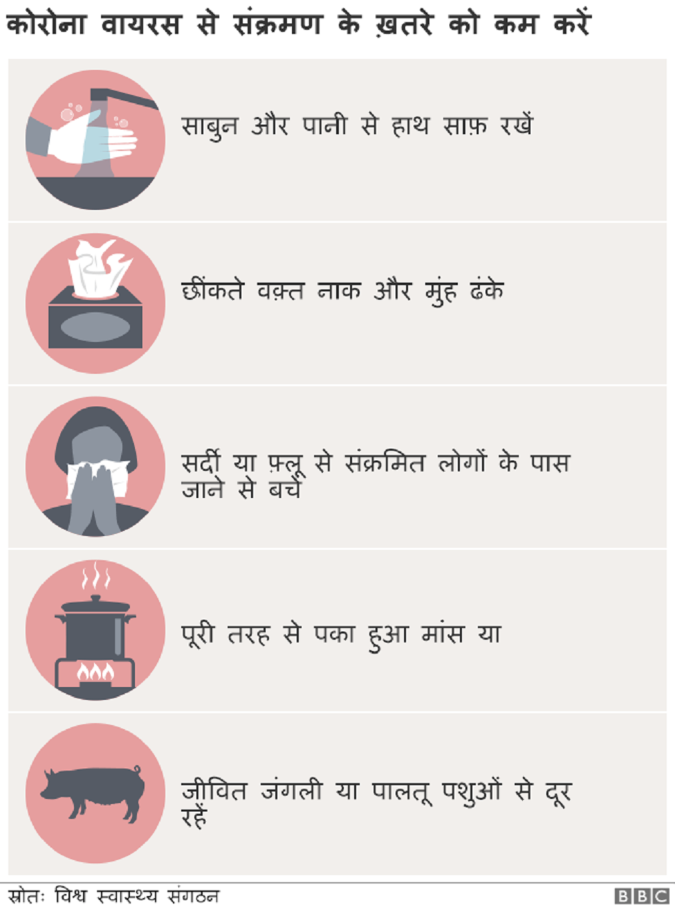
Educate Co-workers
How to prevent it?

Slide 27
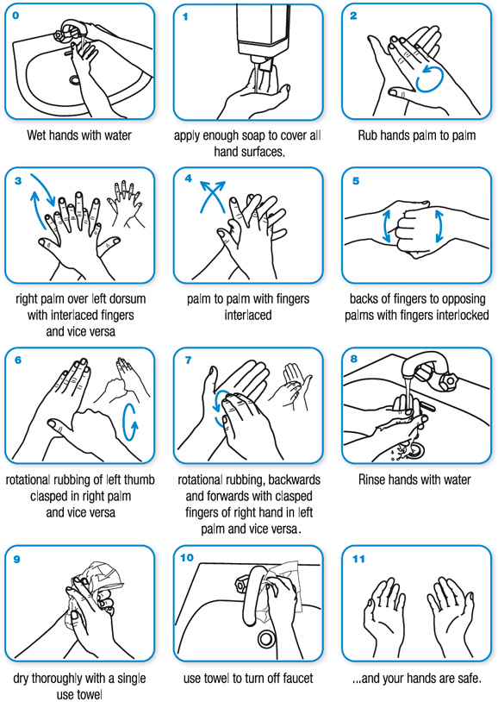
Educate Co-workers
How to wash hands?

Slide 28
Educate Co-workers
Show videos available at Insite
https://insite.holisollogistics.com/user/view_lob_file/7
https://fightcovid.holisollogistics.com/

Slide 29
PROTECT YOURSELF
PROTECT OTHERS

