Slide 2
Warehouse & Last Mile SOP
COVID-2019

Slide 3
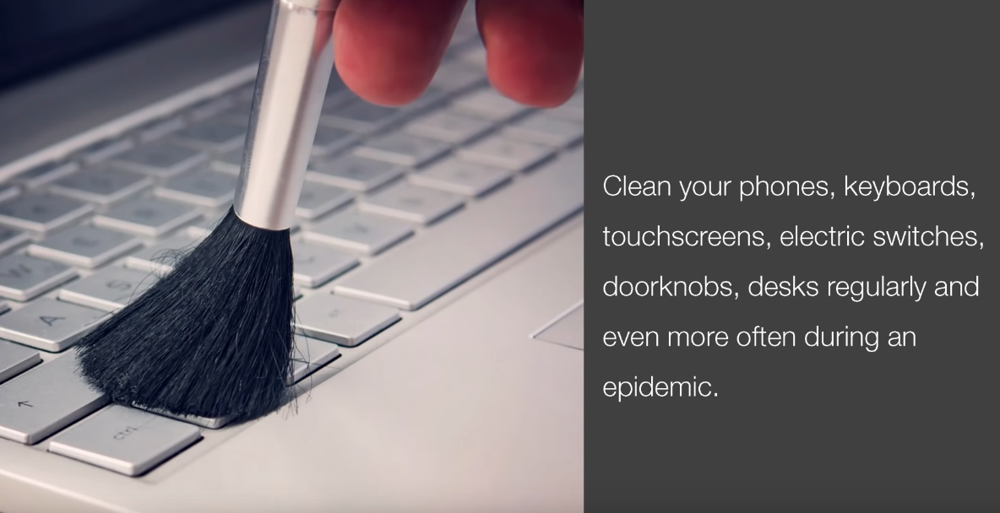
Site Hygiene Guidelines
Ensure availability of following :
liquid soap bottles only
Sanitizers
Disinfectants for cleaning
Masks (spare quantities for backup)
Paper Tissues
Clean drinking water
Vitamin C enriched fruits such as Oranges

Slide 4
Guidelines for Site
Use disinfectants to clean all the surfaces
Entry & Exit gate of building must be disinfected after every 2 hours
Walls & other surfaces also needs to be disinfected and cleaned
Washbasin and washroom must be kept clean to avoid any infection
All machinery in the premise must be disinfected with spray
2hr
Sanitation & housekeeping in the facility after every 2 hours and before new shift starts
All WHO posters must be implemented Prominently displayed at the site
All WHO posters must be implemented Prominently displayed at the site
Daily 10 minutes drill to explain do’s and don’ts to all co-workers
Recording each sick co-worker information and sharing with HR function

Slide 5
Guidelines for Site
1hr
Create the gap of one hour between the shifts
Ensure area is cleaned with disinfectant before new shift
No overlap of shifts is permitted
Mandatory thermal scanning of everyone entering and exiting the area
Sick co-worker must be immediately sent back home and asked to take doctor consultation and rest.
Spitting inside or outside premise is a punishable offence with fine.
Person above 65 years of age and person with co-morbidities and parent of children below the 5 years of age should not be allowed to work in premise.
Share on Display board COVID 19 Hospital/Clinic & Police station contact

Slide 6
Guidelines for Transportation
Special transport facility must be arranged for co-workers coming from outside
All co-workers carrying vehicle will be allowed only 30-40% passenger capacity with social distancing
All vehicles entering the premise must be disinfected with spray

Slide 7
Guidelines related to MASK
Wearing of mask or face cover is compulsory at all times such as:
in transit to work or home
during working at premise
during break periods
during interaction with other co-worker
Mandatory handwash of co-workers:
Before wearing mask or gloves
After removing mask or gloves
Break for 5 mins every hour for hand wash
Before & after lunch
Before & after tea breaks

Slide 8
MHA SOP Procedure for Social Distancing
The following measures shall be implemented by all offices, factories and other establishments:
All areas in the premises including the following shall be disinfected completely using user friendly disinfectant mediums:
Entrance/gates of building/office etc.
Cafeteria & Canteens
Meeting room, conference halls /open areas available. veranda/entrance gates of sites/bunkers, porta cabins, building etc.
Equipment & Lifts
Washroom, toilet, sink, water points etc.
Walls / all other surfaces
For workers coming from outside, special transportation facilities will be arranged without any dependency on public transport system. These vehicles should be allowed to work only with 30-40 % passenger capacity.
All vehicles and machinery entering the premises should be disinfected by spray mandatorily.
Mandatory thermal scanning of everyone entering and exiting the workplace to be done.

Slide 9
MHA SOP Procedure for Social Distancing
Medical insurance for the workers to be made mandatory.
Provision for handwash and sanitizer preferably with touch free mechanism will be made at all entry and exit points and common areas. Sufficient quantities of all items should be available.
Workplace shall have a gap of one hour between shifts and will stagger the lunch breaks of staff, to ensure social distancing.
Large gatherings of meetings of 10 or more people to be discouraged. Seating at least 6 feet away from others on job sites and in gatherings, meetings and training sessions.
Not more than 2/4 persons (depending on size) will be allowed to travel in lifts or hoists.
Use of staircase for climbing should be encouraged.
There should be strict ban on gutka, tobacco etc and spitting should be strictly prohibited.
There should be total ban on non-essential visitors at site.
Hospitals/clinic in the nearby areas, which are authorized to treat COVID-19 patients, should be identified and the list should be available at the workplace all the times.

Slide 10
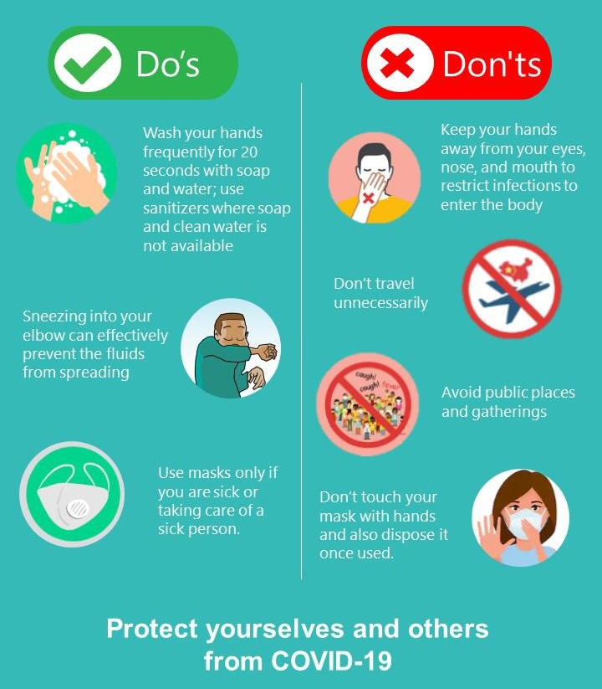
Do’s & Don’ts

Slide 11
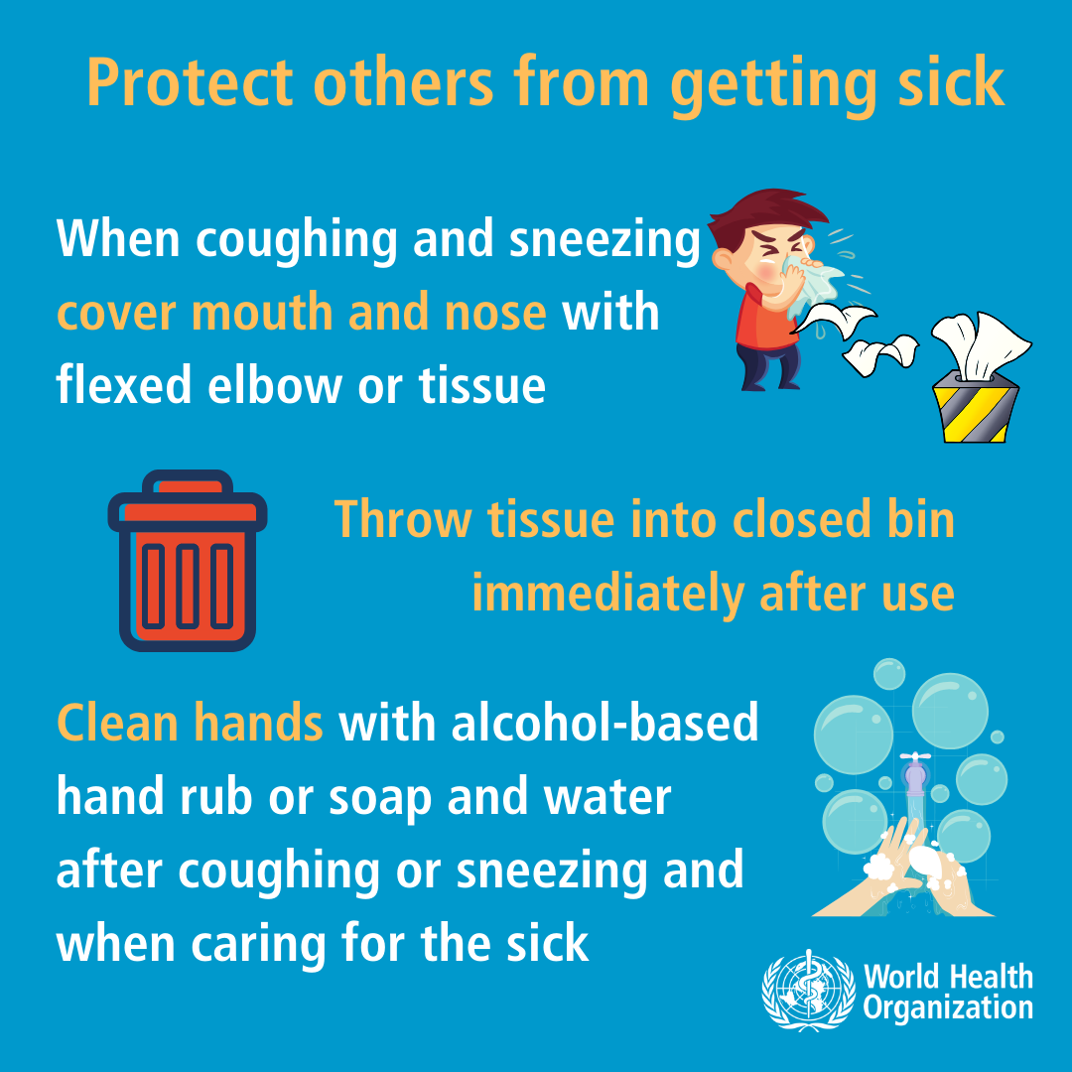
Do’s

Slide 12
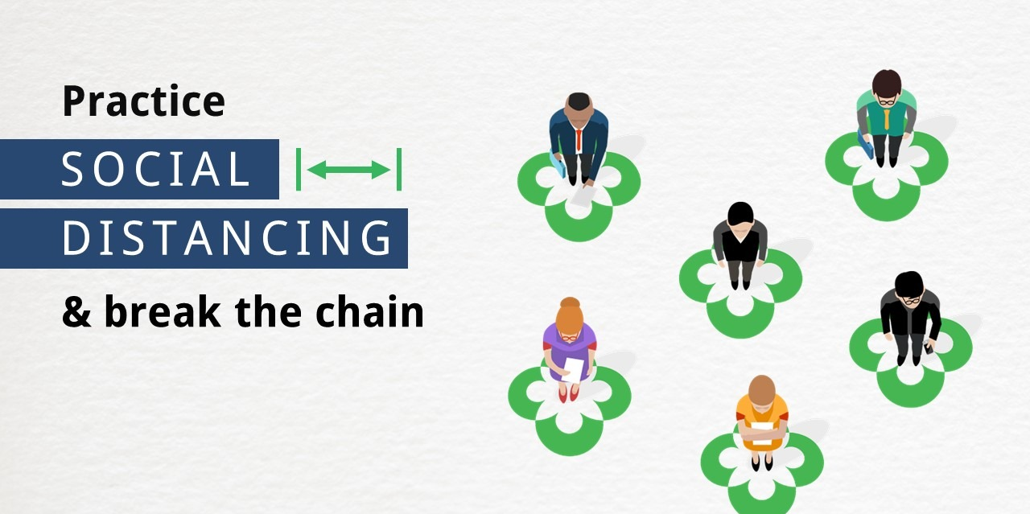
Do’s
2 Meter

Slide 13
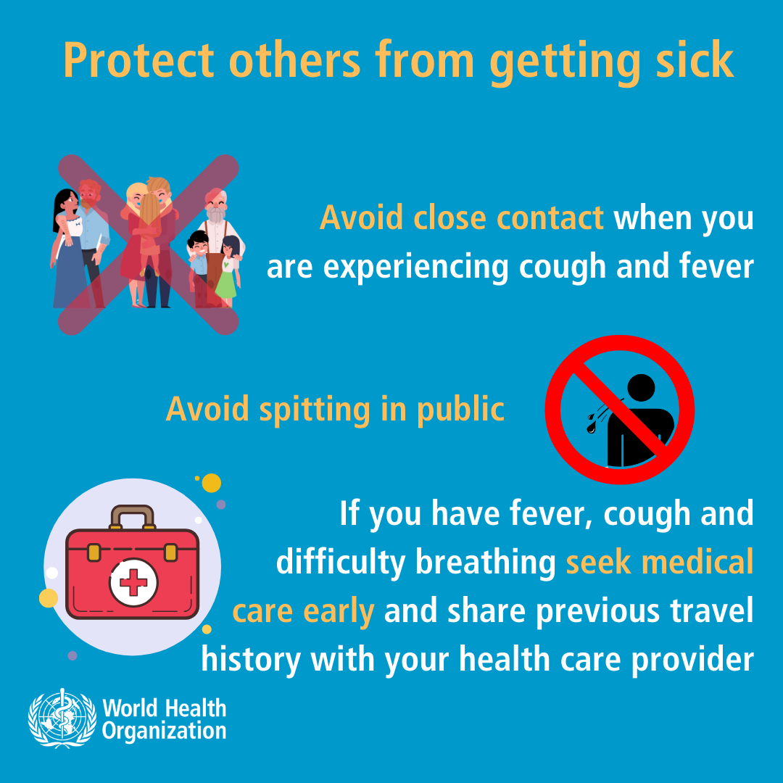
Don'ts

Slide 14
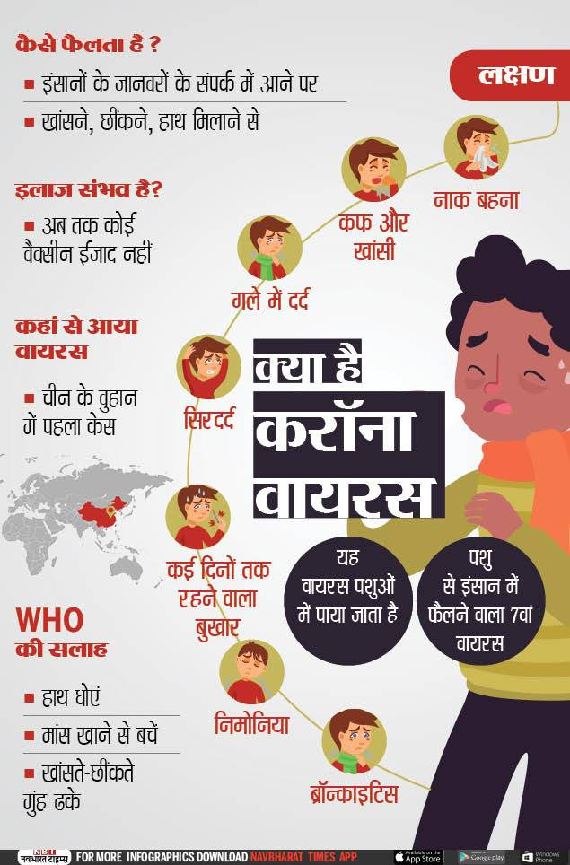
Educate Co-workers
How it spreads ?

Slide 15
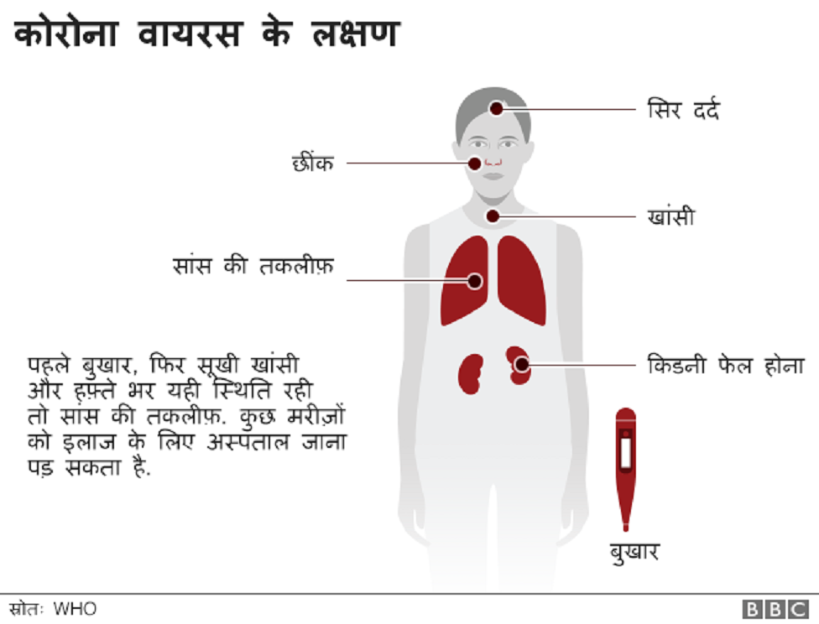
Educate Co-workers
Symptoms of COVID-2019

Slide 16
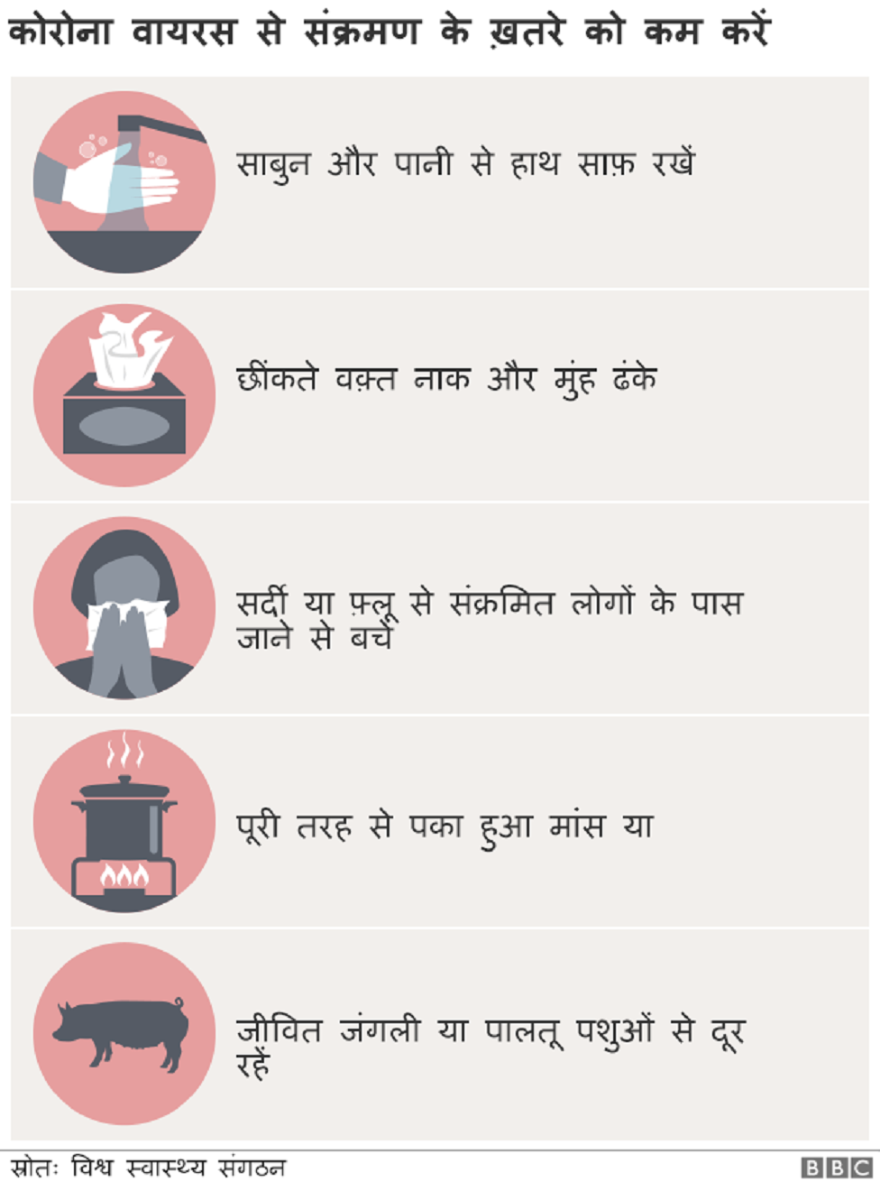
Educate Co-workers
How to prevent it?

Slide 17
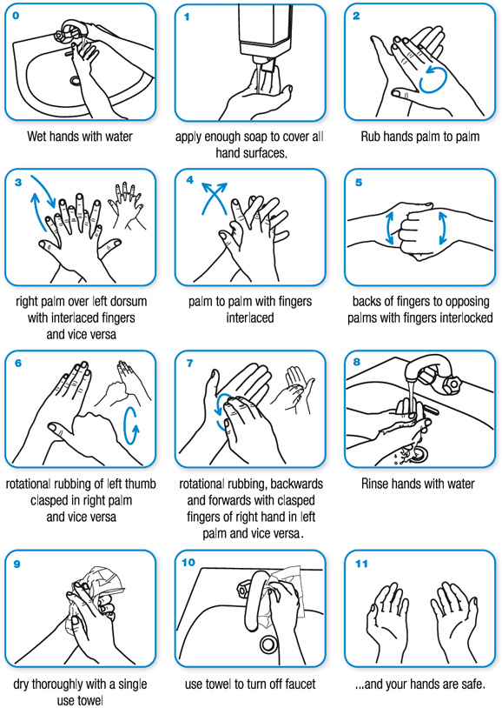
Educate Co-workers
How to wash hands?

Slide 18
Educate Co-workers
Show videos available at Insite
https://insite.holisollogistics.com/user/view_lob_file/7

Slide 19
PROTECT YOURSELF
PROTECT OTHERS

